Slide 1


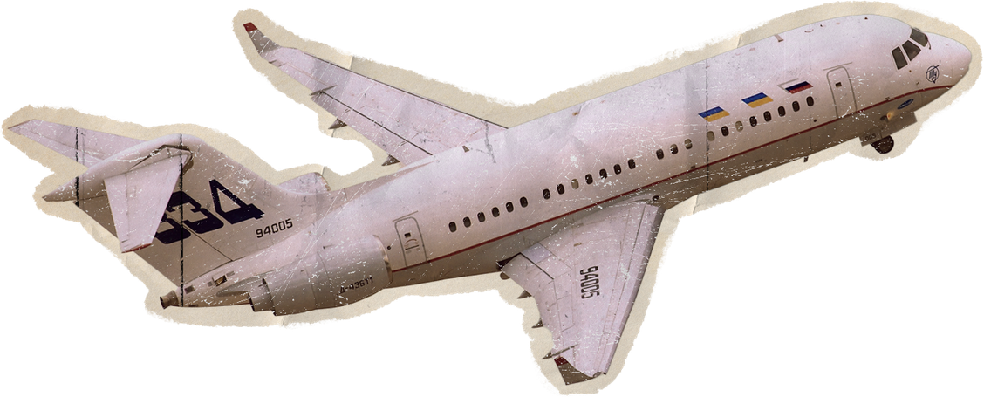

Group No. - SEDA_08
AeroSlot Scheduler
Smart Runway Scheduling for safe and efficient skies
Group Members:
Prachi Dudhankar
Anushka Pise
Onkar Bansode
Pratiksha Dharne
Shweta Yede

Slide 2
Problem Statement
Traditional runway scheduling struggles under growing air traffic complexity.
Inefficient Runway Utilization
Flight Dealys and Congestion
Static / Manual Scheduling
Lack of Predictive Delay Intelligence
No Adaptive Scheduling Under Critial Conditions
Poor Emergency Handling

Slide 3
Proposed Solution
We developed an AI-assisted runway scheduling system that combines prediction, optimization, safety constraints, and real-time control to improve airport operations.
Intelligent Flight Scheduling
AI / ML Delay Prediction
Conflict-Aware Safe Scheduling
Dynamically schedules aircraft landings and takeoffs, optimizing runway slots based on priority, congestion, and safety.
Predicts delays before congestion escalates, estimates conflict risks, and recommends scheduling actions.
Manages wake turbulence separation, detects runway interval conflicts, and applies dynamic safety buffers.
Hybrid Adaptive Scheduling Engline
Core Optimization Objective
Uses multiple scheduling algorithms and automatically switches based on traffic condition:
Normal traffic → FCFS
Congestion → Greedy Min Delay
Emergencies → Preemptive, Priority
High-risk situations → Hybrid Adaptive AI
Optimizes scheduling by minimizing delay and conflict risk while maximizing throughput.

Slide 4
Key Features
Smart Runway Slot Allocation
AI Delay Prediction
Selects least-loaded runways, assigns optimal slot times, and ensures separation-safe schedules.
Predicts possible delays before they happen.
Dynamic Priority Scheduling
Conflict Detection & Safety Validation
Ranks aircraft intelligently:
Ranks aircraft intelligently:
Emergency Premptive Scheduling
Automatic Algorithm Switching
Critical flights can override queue instantly.
System switches algorithm based on:
congestion ,emergencies, storm risk, conflict probability

Slide 5
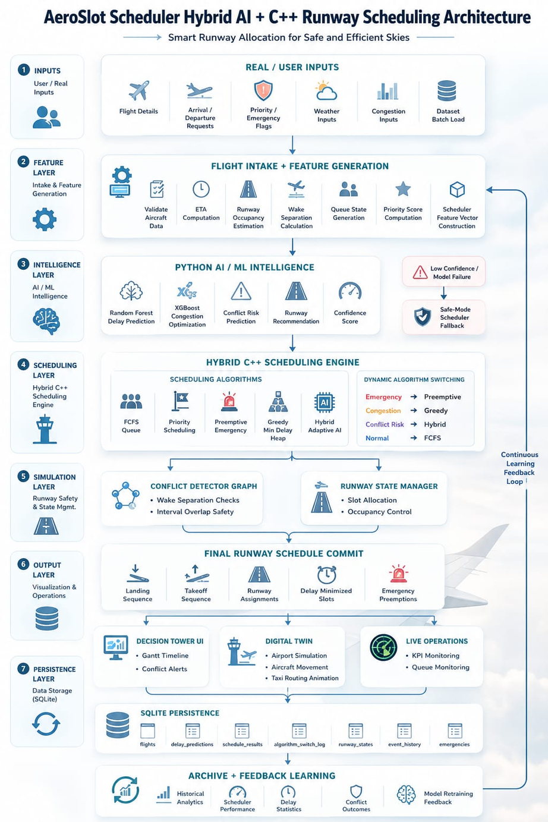
System Architecture

Slide 6







Technology Stack
Frontend
AI / ML
Models
Random Forest
XGBoost
Backend
Database

Slide 7
Datasets and Data Fusion Pipeline
Historical Flight Delay 3 Dataset
(kaggle)
OpenSky State Vectors
(2017–2022)
Data Fusion Pipeline
Rather than using datasets independently, the system combines them into one Merged Aviation Intelligence Dataset
+ OpenSky Trajectories
+ Aircraft Metadata
+ Amelia Surface Operations
+ Historical Delay Data
↓
Merged Aviation Intelligence Dataset
↓
ML Models + C++ Scheduling Engine
Data Fusion Pipeline
OpenSky AirCraft Metadata (2021-2025)
Amelia 42 Mini Dataset

Slide 8
Scope & Limitations
Immediate & Future Scope
Limitations
Smart Single-Airport Runway Optimization
Real-Time Intelligent Scheduling
Delay Prediction & Decision Support
Multi-Airport Network Scheduling
Digital Twin Expansion
Single-Airport Focus
ML Accuracy Depends on Data Quality
Prototype-Scale Dataset Usage

Slide 9
Thank You

